Slide 1
Presentation on Web Programming Laboratory Project
Project Name : Sardah Government Pilot High School, Rajshahi
(PHP based website)
Presented to:
Mahmudul Hasan Lecturer, Dept. of CSE, KUET
&&
Protty Saha
Lecturer, Dept. of CSE, KUET
Presented by:
Md Noyan Ali
Roll - 1607021

Slide 2
My Project
I have created this website for my high school under some constraints that are given in our lab by our respected teachers. I have developed this website with raw coding. No template has been used in this website.
The key features:
Home Page
About
Teachers
Clubs
Facilities
Admission
Automation - Sign Up, Sing In & Sing Out
Auto Logged In (Using Cookie)

Slide 3
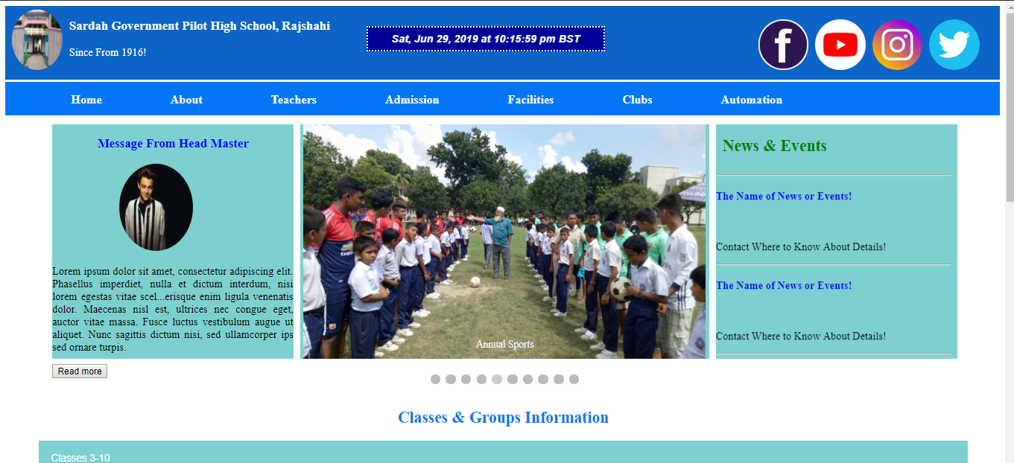
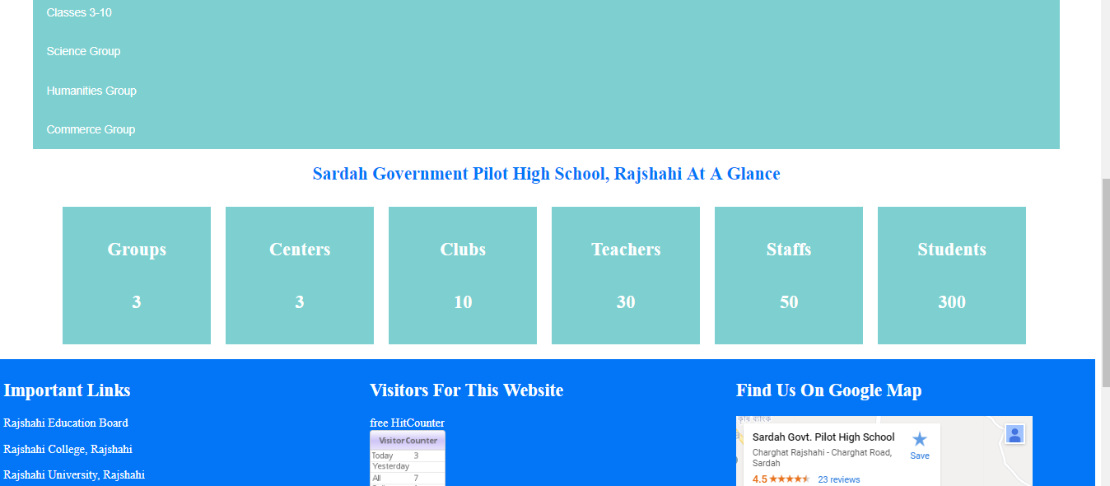
Home Page

Slide 4
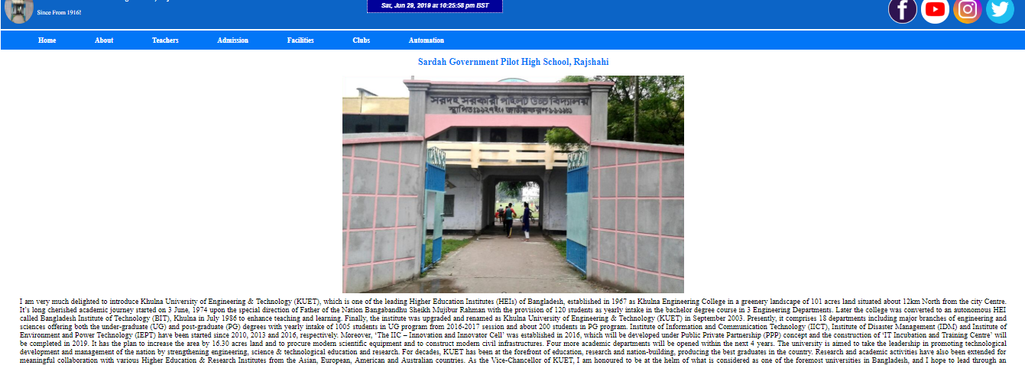
About

Slide 5
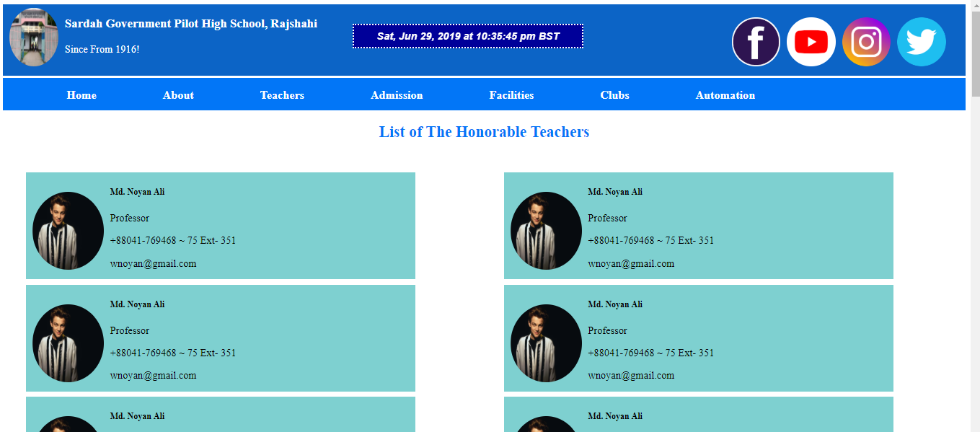
Teachers

Slide 6
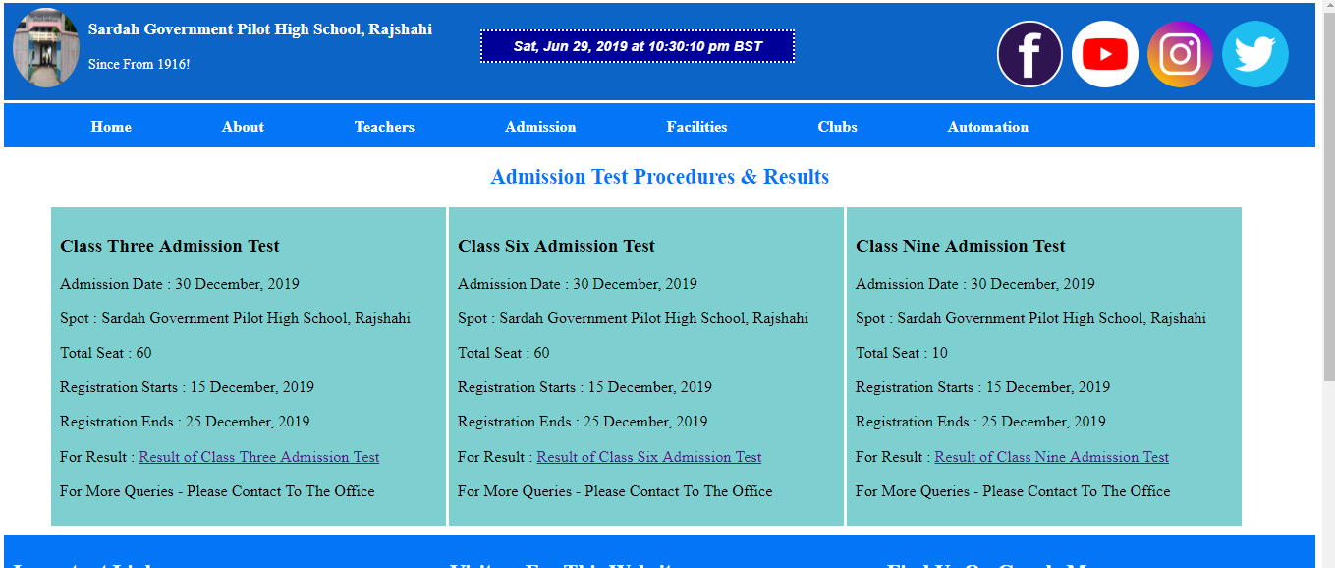
Admission

Slide 7
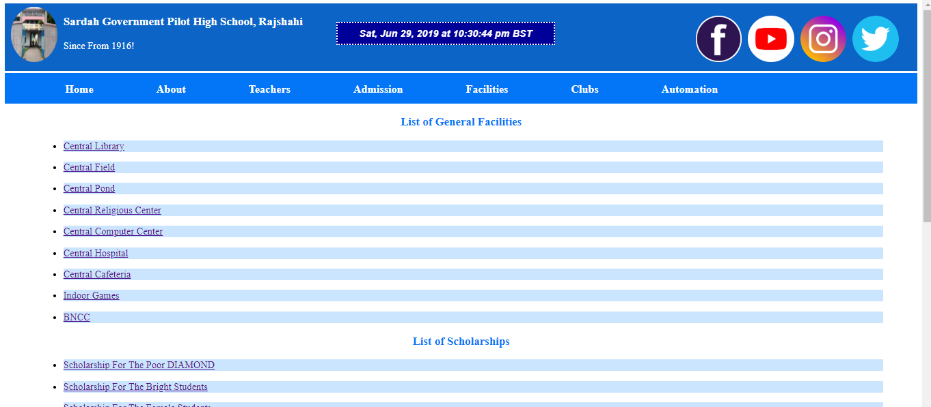
Facilities

Slide 8
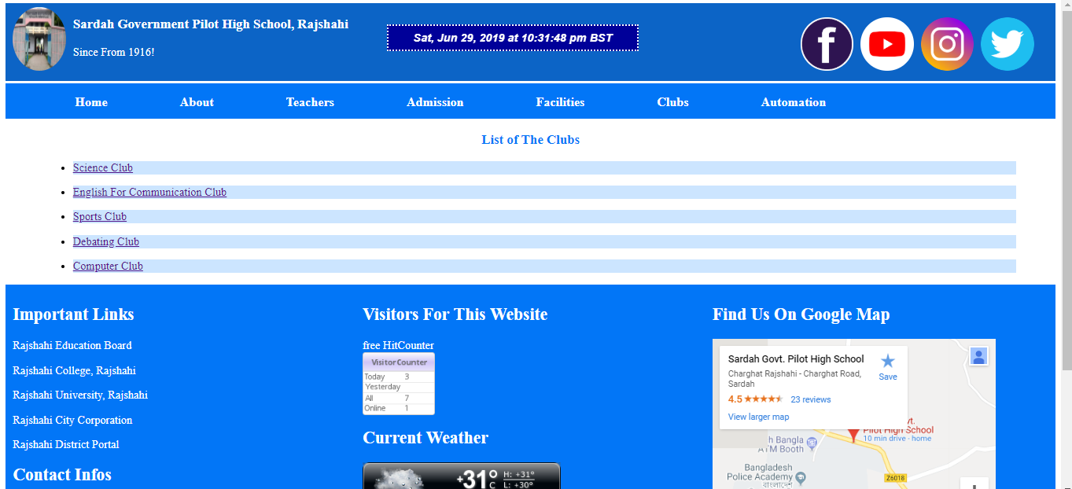
Clubs

Slide 9
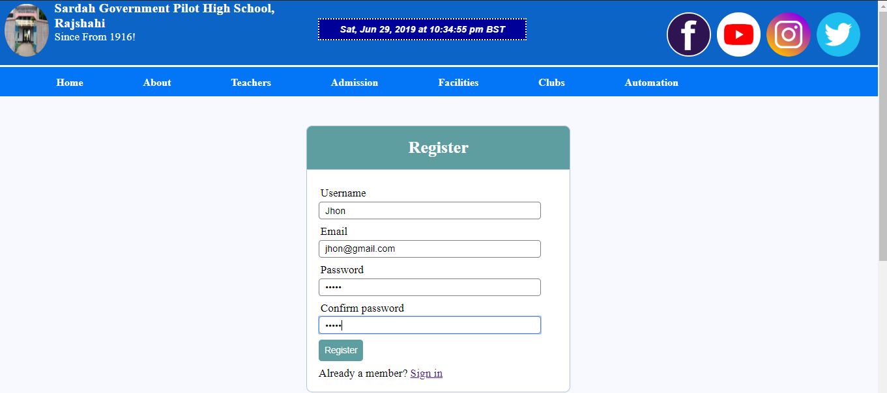
Registration

Slide 10
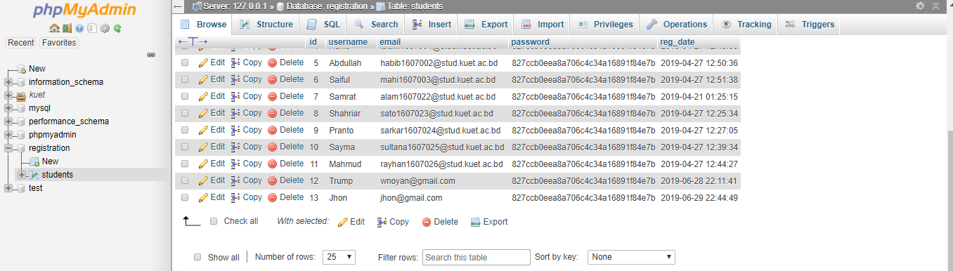
Database

Slide 11
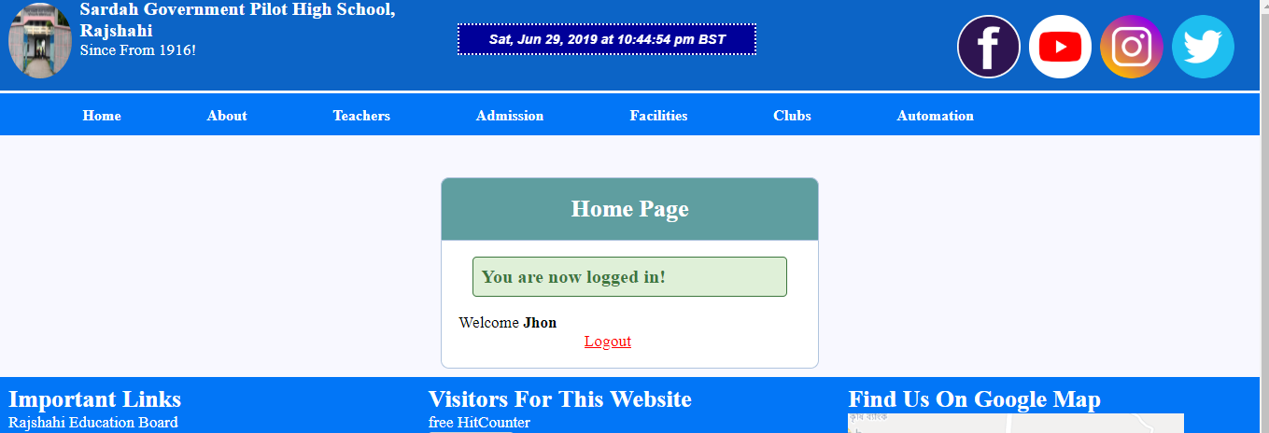
Welcome

Slide 12
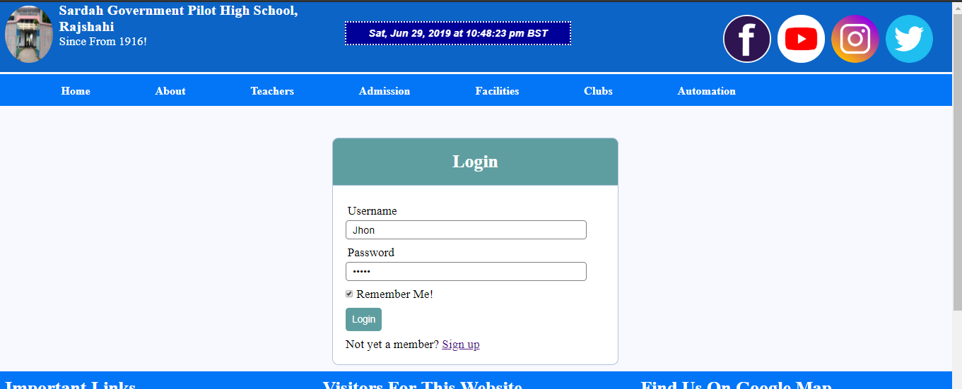
Log In

Slide 13
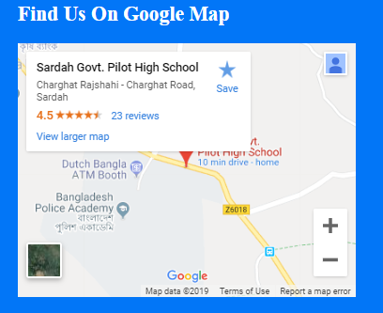
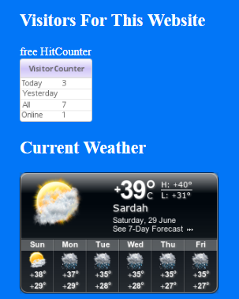

Polishing
For polishing purpose I have added Google location, visitor counter , weather casting, date & time and many features like this.

Slide 14
Programming Features
I have implemented all the features that have been experimented in our lab. The features are noted below:
HTML
CSS
PHP
MySQL
Database
JavaScript
Session
Cookie
XAMPP

Slide 15
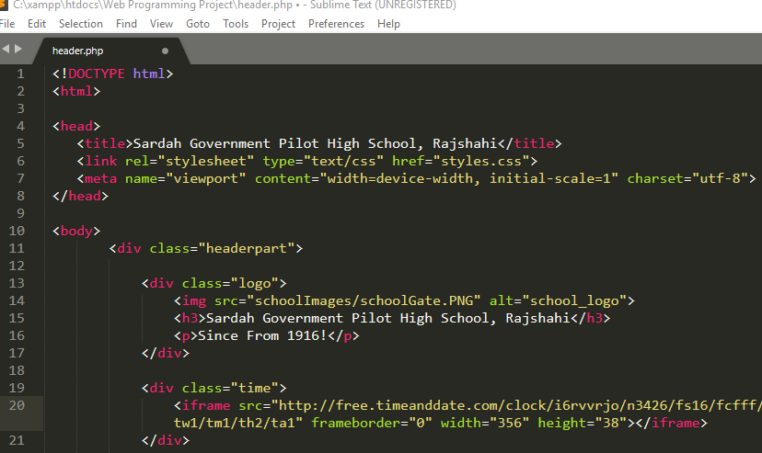
HTML
HTML – Hyper Text Markup Language is used for creating a webpage. It determines the structure of the webpage.
HTML used in my project:

Slide 16
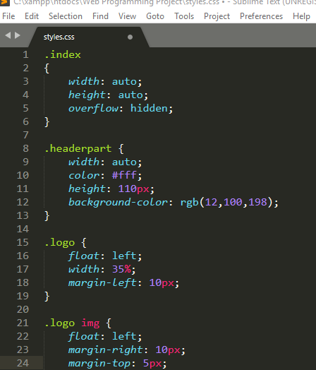
CSS
CSS – Cascading Style Sheets describe how HTML elements are to be displayed on screen. It is used for designing purpose of webpage.
CSS used in my project:

Slide 17
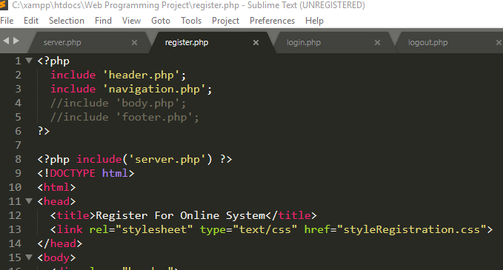
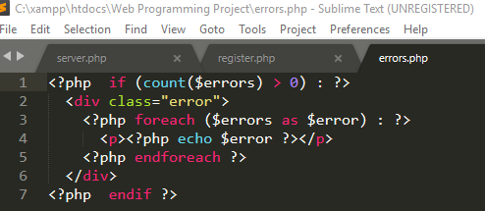
PHP
PHP – Hypertext Pre-Processor is a server side scripting language. It is used to develop websites or web-applications and can be embedded into HTML.
PHP used in my project:

Slide 18
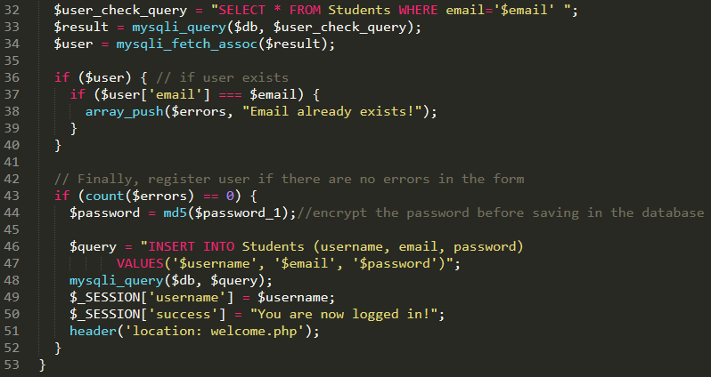
MySQL
MySQL – It is open source RDBMS that uses Structured Query Language. SQL is the most popular language for adding, accessing and managing content in a database.
MySQL used in my project:

Slide 19
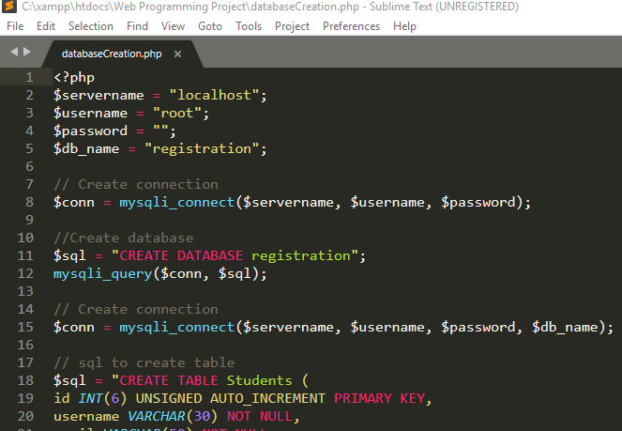
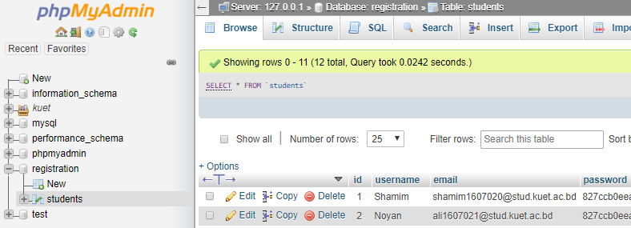
Database
Database – I have used PHP Admin for database. It is the most popular MySQL administration tool that is used by millions of users worldwide.
Database used in my project:

Slide 20
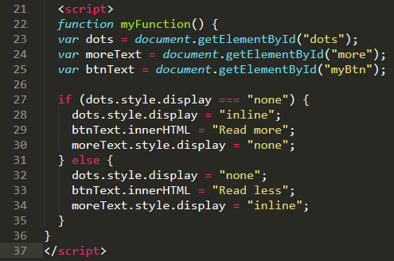
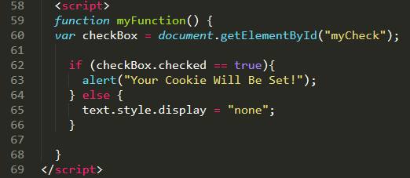
JavaScript
JavaScript – It is called a Client-Side Scripting Language. It determines the behavior of the web pages.
JavaScript used in my project:

Slide 21
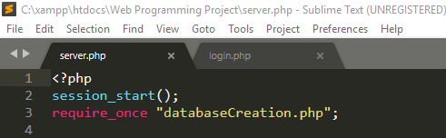
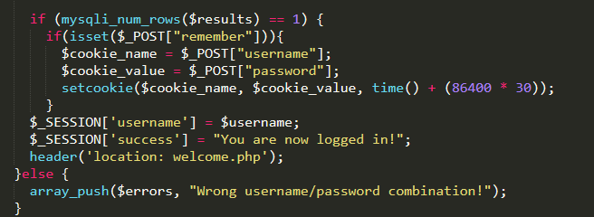
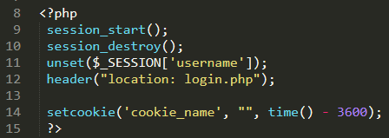
Session
Session – A session is a way to store information to be used across multiple pages. In PHP, by default session data is stored in files on the server.
Session used in my project:

Slide 22
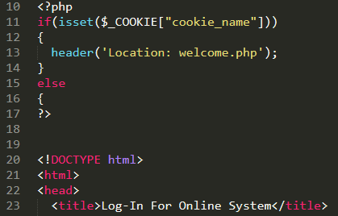
Cookies
Cookies – Cookies are small data packets which web pages load on to browsers for a whole range of season.
Cookies used in my project:

Slide 23
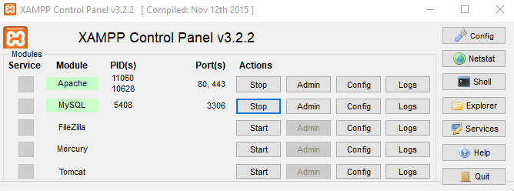
XAMPP
XAMPP – XAMPP stands for Cross-Platform, Apache, MySQL, PHP and Perl. It is simple and lightweight Apache distribution that makes it extremely easy for developers to create a local web server for testing purposes.
XAMPP used in my project:

Slide 24
GitHub Link
Find My Project on GitHub – https://github.com/wnoyan/pacademic.git
You are invited to watch and contribute to my website to make it awesome. Just pull your request on my project and I will pull up your request to make it awesome if your request is relevant. So I am waiting for your contribution, man! Just make it great.

Slide 25
The End
This is the end! Any Question ?
Thanks!

